Slide 1

Computer repair and maintenance coursework presentation.
BY
RICHARD EDWARD WALYAULA.
VU-BIT-2109-0675-DAY.

Slide 2


DISK CLONING.
Transfer of programs/applications, files and operating systems from one storage media to another/ONE PARTITION TO THE OTHER.
Its done without necessarily affecting the functionality of programs, uninstallation and also loss of data.
Reasons for disk cloning.
Insufficient storage space on local disk C.
Need to upgrade from HDD to SSD.
Failures detected on the existing drive on which programs are installed.
Need for backup.

Slide 3
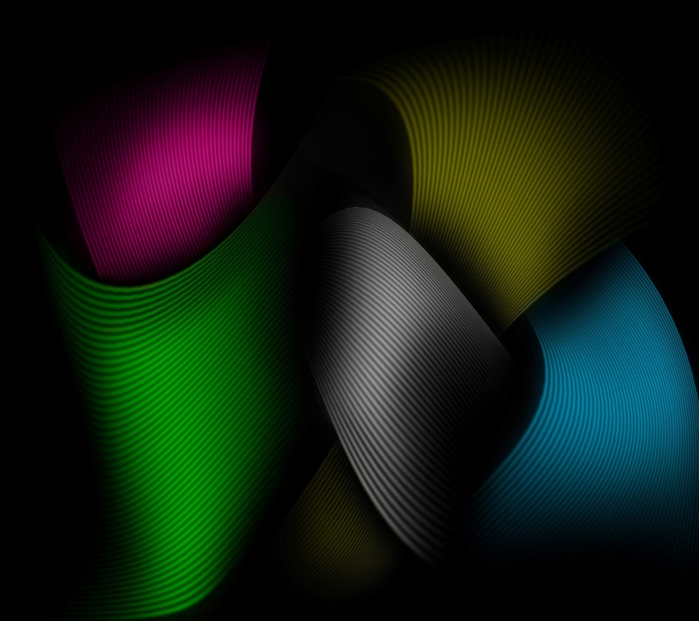
PRECAUTIONS UNDERTAKEN.
Back any important data.
Check the storage media compatibility-
the destination drive must have a bigger storage capacity than the source drive.
Determine the type of account in use before.
User accounts on the system with less privileges are denied access hence may not clone.

Slide 4
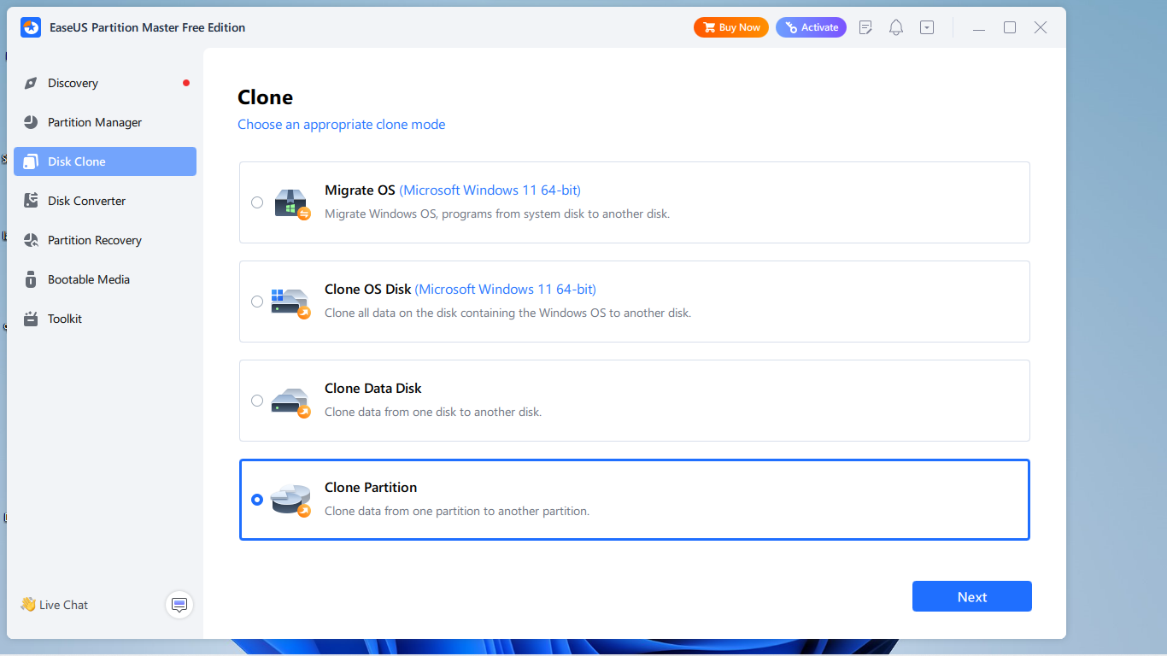
DISK CLONING PROCESS.
The software used- Easeus partition master.
PROCEDURES.
Download and launch the Easeus partition master software or any other tool for cloning.
Locate the disk clone option on the start page interface and click on it
Select the mode of clone -PARTITIONS
select the source partition and the destination.
Click next to start the cloning process.

Slide 5
REBOOTING
After cloning completion, restart the computer and
reboot from the target(destination)drive.
the system will enact the changes and hence programs will begin running from the d drive.
THANKS FOR YOUR AUDIENCE.

